Slide 1


Slide 2




PnPjs – Your New SharePoint and Office365 Development Friend
Sergei Sergeev
SharePoint & Office365 developer, consultant
Belarus

Slide 3
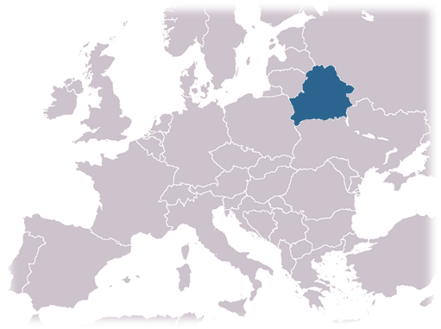





About me
9+ years with SharePoint
Microsoft MVP (2017 - current)
Open source contributor
Local Belarus SPUG speaker
Developer and owner at mastaq
Online identities
http://spblog.net
@sergeev_srg
https://mastaq.com
github/s-KaiNet
in/sergeisergeev

Slide 4





Our journey!
2. Why REST API?
4. DEMO Pack
6. DEMO
1. Evolution of SharePoint data access methods
5. PnPjs advanced topics
3. Welcome PnPJS!

Slide 5
Agenda
Evolution of SharePoint data access methods
Why REST API?
Welcome PnPjs!
DEMO Pack
PnPjs advanced topics
DEMO

Slide 6
Evolution of SharePoint data access methods
2007
2013, Online
2019 -
SSOM Web Services
SSOM Web Services CSOM, JSOM
REST
SSOM Web Services CSOM, JSOM
REST
SSOM Web Services CSOM
SSOM Web Services CSOM, JSOM
REST
2010
2016

Slide 7
Why REST?
Commonly used standard across a lot of applications
A method to interact with a resource in a known way
Platform independent

Slide 8
Consuming REST API: common developer issues
Documentation
Inconvenient string manipulation
Typo errors
Code readability

Slide 9
Welcome PnPjs
PnPjs soon
PnPjs today
even further in future
Fluent interface
Type checking
& intellisense
Other goodies (batching, caching, parsers, etc.)
PnPjs
SharePoint REST API
MS Graph API

Slide 10
PnPJS 2.0 is coming!
Improved library size (smaller chunks)
Improved fluent syntax
Improved documentation and test coverage
Limited IE11 support

Slide 11



Slide 12
SharePoint versions
SharePoint Online
SharePoint 2013, 2016, 2019

Slide 13
SharePoint REST API in PnPjs
ALM
Attachments
Client-side Pages
Features
Fields
Files
List items
Navigation
Permissions
Related Items
Search
Sharing
Social
Tenant
Views
Webs
Site designs
Taxonomy
Site scripts
Comments & Likes

Slide 14
MS Graph API in PnPjs
Users
Plans
Pages
Sections
Notebooks
Members
Groups
Senders
Posts
Threads
Conversations
Events
Teams
Attachments
Calendars

Slide 15
DEMO Pack
SPFx + local dev
SPFx with MS Graph
Web app
Nodejs

Slide 16
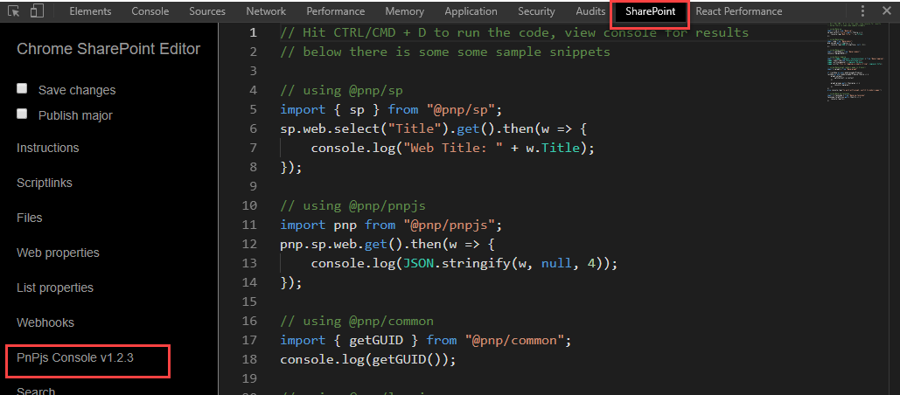
PnPjs in-browser testing

Slide 17
Helpers, utilities and advanced features
Batching
Caching
Business Objects
Response parsers
NodeJS
Library configuration

Slide 18
DEMO
Outlook add-in with PnPjs

Slide 19
Resources
https://github.com/pnp/pnpjs - PnPjs sources
https://pnp.github.io/pnpjs/ - PnPjs Docs
https://github.com/koltyakov/sp-rest-proxy - SharePoint REST API Proxy for local Front-end development tool-chains
https://github.com/AzureAD/azure-activedirectory-library-for-js - Active Directory Authentication Library (ADAL) for JavaScript
https://chrome.google.com/webstore/detail/sp-editor/ecblfcmjnbbgaojblcpmjoamegpbodhd?hl=en – SP Editor Chrome addin
https://github.com/SharePoint-NodeJS/pnp-auth - Nodejs to SharePoint auth options for PnPjs
https://github.com/jquintozamora/react-typescript-webpack2-cssModules-postCSS - react starter template used in web app demos
https://github.com/s-KaiNet/PnPjs-your-friend-demos - sources for demos

Slide 20

Thank you!
https://mastaq.com
http://spblog.net
@sergeev_srg
github/s-KaiNet
in/sergeisergeev

